Slide 1
冒險故事

Slide 2
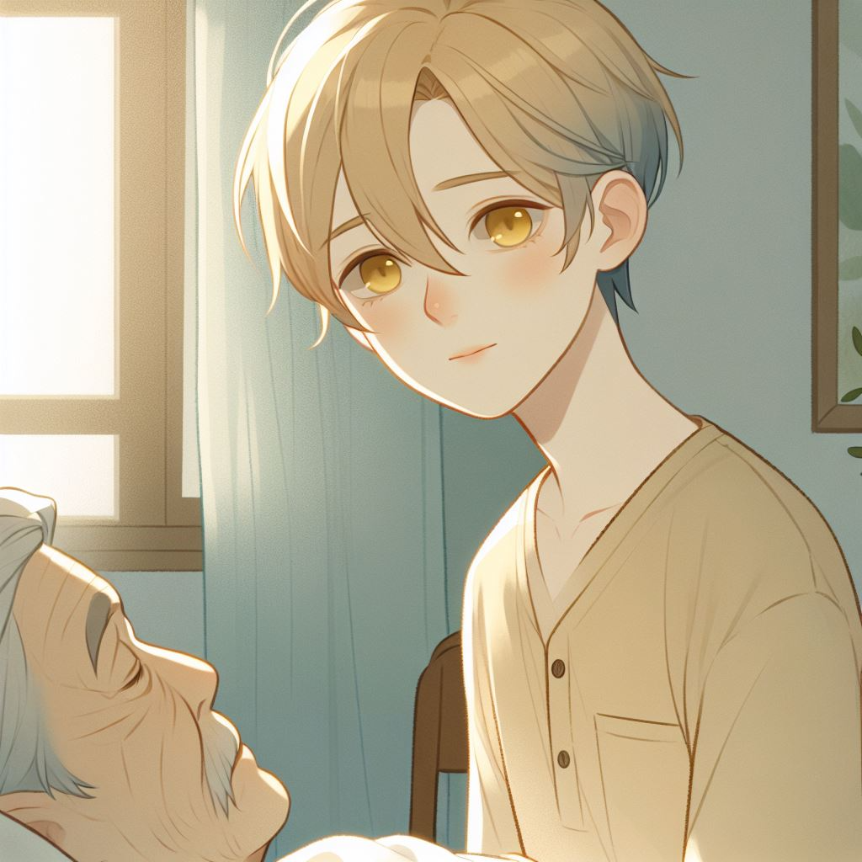
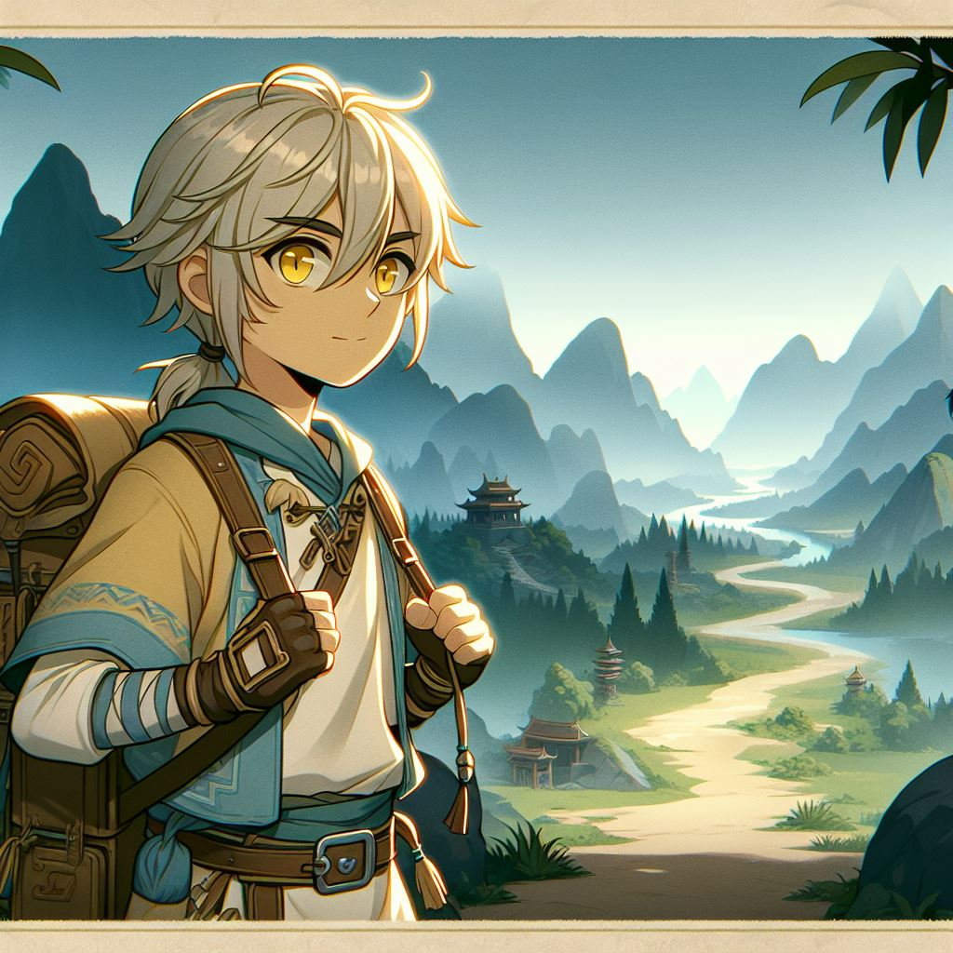
1. 目標
Notes:
Anime-style illustration of a character named Ming, with fair skin, short hair mixed with blond and blue, and yellow eyes. The setting is a quiet room where Ming is visiting his grandfather, who is lying in bed. Ming has a gentle and caring expression as he looks at his grandfather. The room has a soft, warm atmosphere, capturing the tenderness of the moment in a Japanese anime style.
Anime-style illustration of a character named Ming, with fair skin, short hair mixed with blond and blue, and yellow eyes, setting out on an adventure to find a cure for his grandfather. Ming is dressed in a travel outfit, equipped with a backpack and a determined expression as he walks along a path that leads through a mystical landscape. The background shows mountains, forests, or distant temples, symbolizing the beginning of a long and challenging journey. The scene captures a sense of hope, courage, and purpose in classic Japanese anime style.

Slide 3
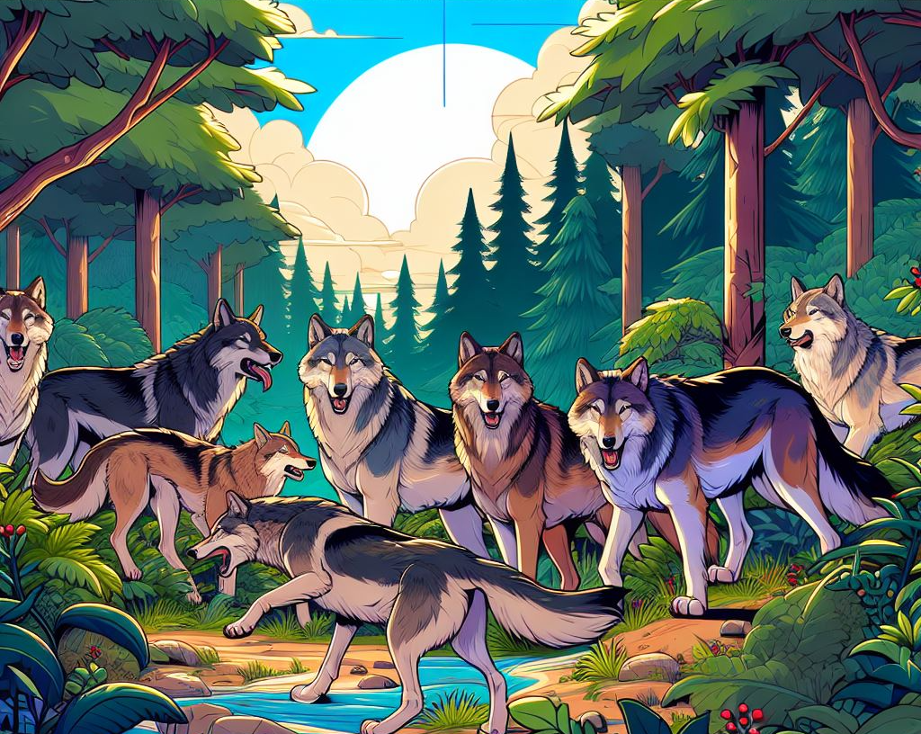
2. 阻礙
Notes:
生成動漫風格的狼群圖片

Slide 4
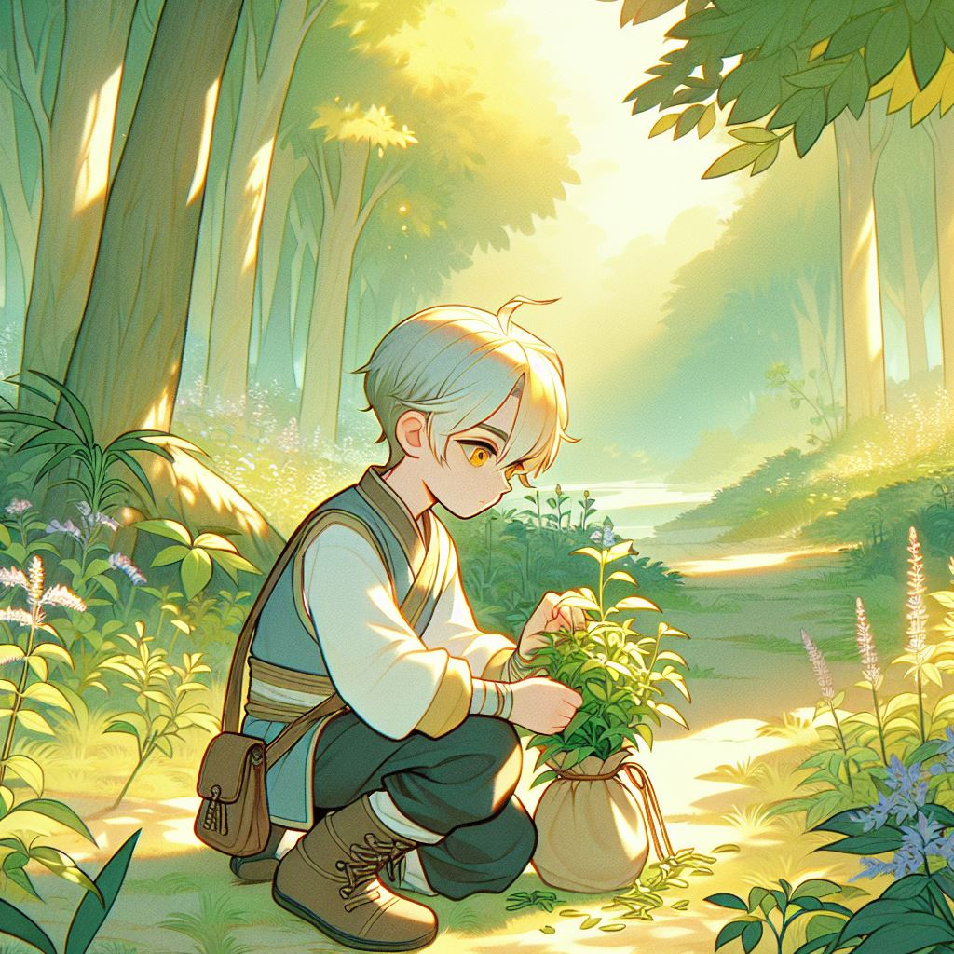
3. 努力
Notes:
Anime-style illustration of a character named Ming, with fair skin, short blond and blue hair, and yellow eyes, carefully gathering medicinal herbs in a serene forest. Ming kneels down, gently picking herbs with a focused expression, carrying a small satchel or basket for the plants. The forest is lush and vibrant, with soft sunlight filtering through the trees, creating a peaceful and natural atmosphere. The scene captures Ming’s dedication and care on his journey to find a cure for his grandfather in a classic Japanese anime style.

Slide 5
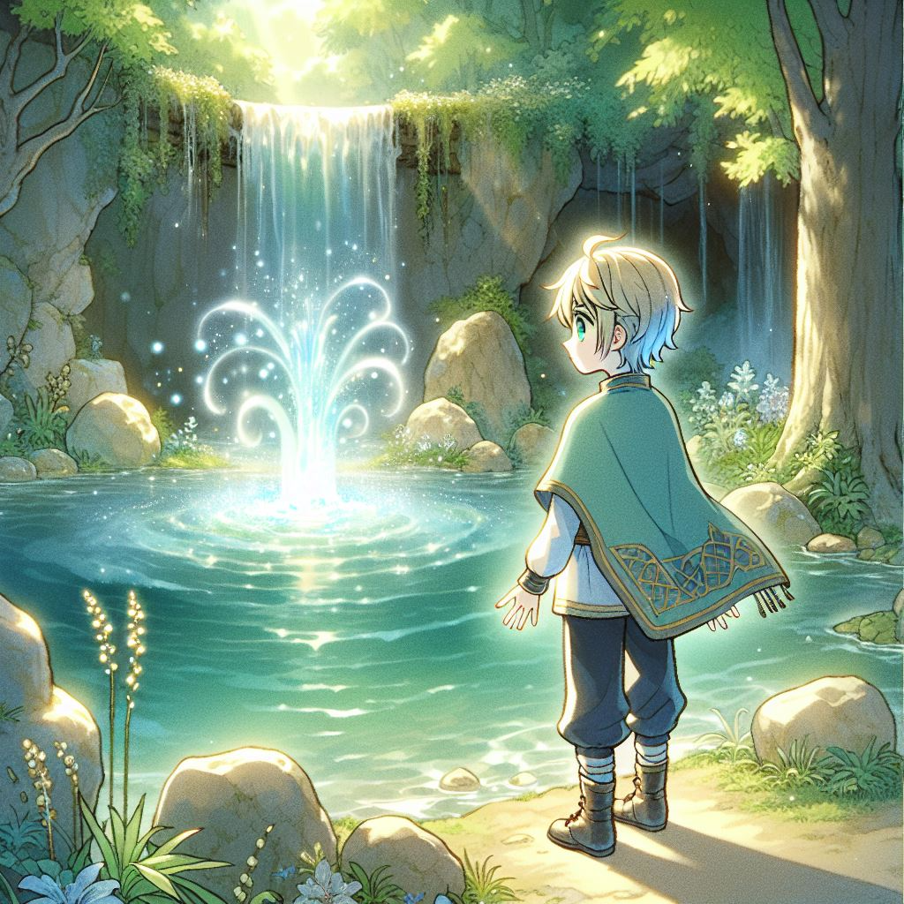
4. 結果
Notes:
Anime-style illustration of a character named Ming, with fair skin, short blond and blue hair, and yellow eyes, arriving at a beautiful location with a sparkling, magical spring. Ming stands at the edge of the spring with an awe-inspired and relieved expression, surrounded by lush greenery, ancient stones, and soft, ethereal light illuminating the water. The spring emits a gentle glow, suggesting healing powers, and the scene captures a sense of accomplishment and hope in Ming’s quest to cure his grandfather, rendered in a classic Japanese anime style.

Slide 6
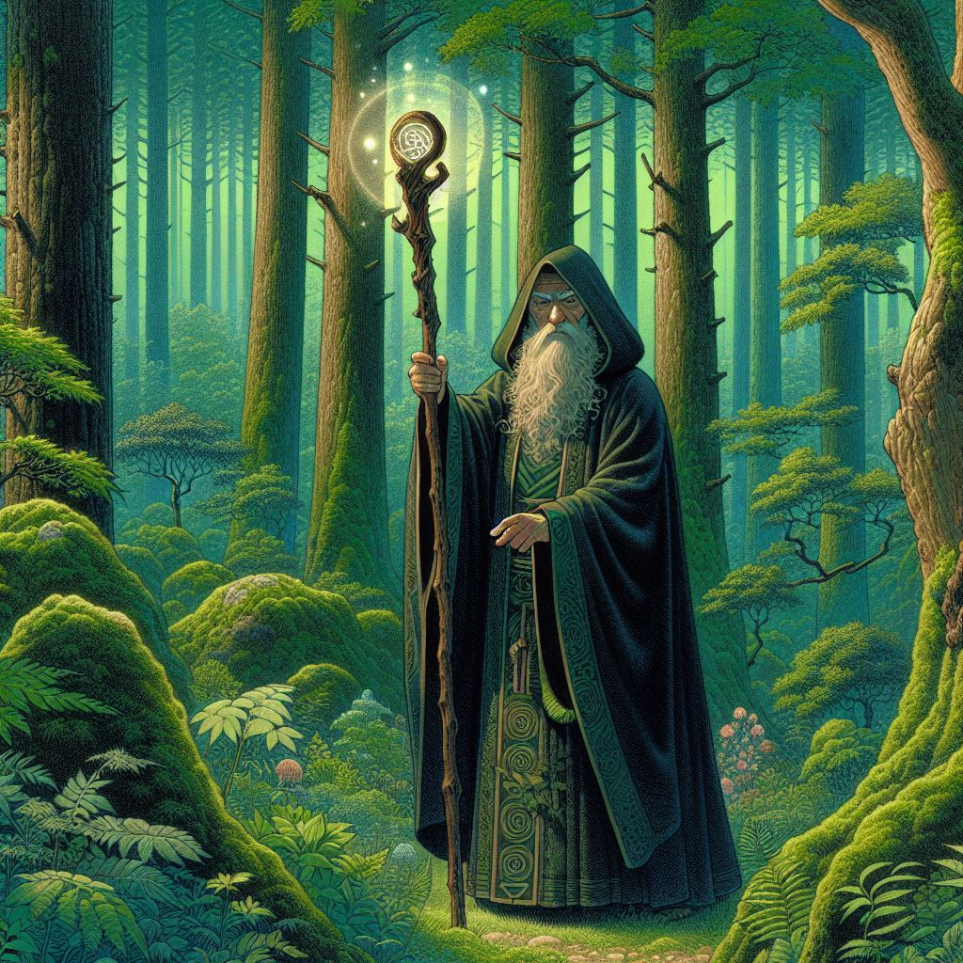
5. 意外
Notes:
生成一位在森林裡穿著斗篷的神祕巫師圖片，日本動漫風格

Slide 7
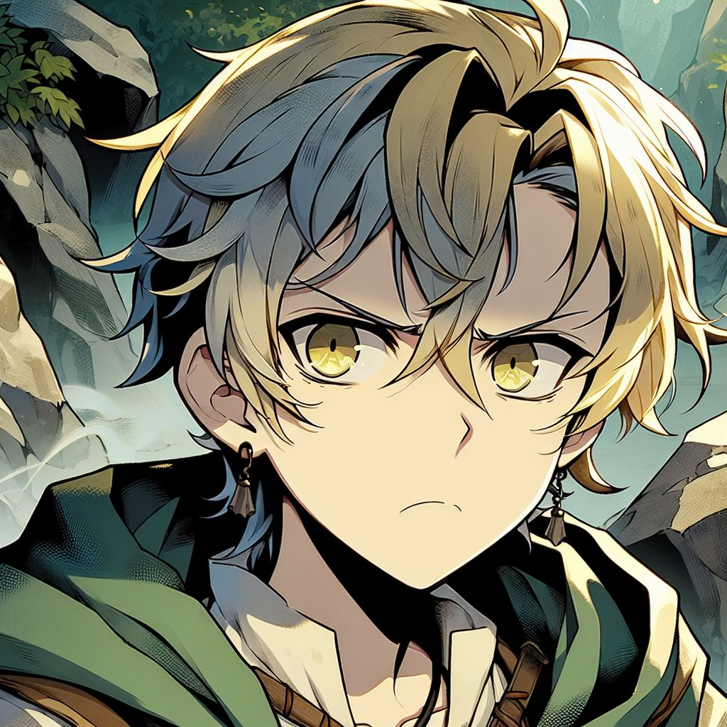
6. 轉彎
Notes:
Anime-style illustration of a character named Ming, with fair skin, short blond and blue hair, and yellow eyes, looking frustrated and troubled as he finds himself in a challenging situation. Ming’s expression shows annoyance and worry, as he realizes the obstacles in his quest. He is surrounded by rocky terrain or dense forest, symbolizing the difficulty of his journey. The atmosphere is tense, with shadows and a slightly darker color palette, capturing the emotion of frustration and determination in a classic Japanese anime style.

Slide 8
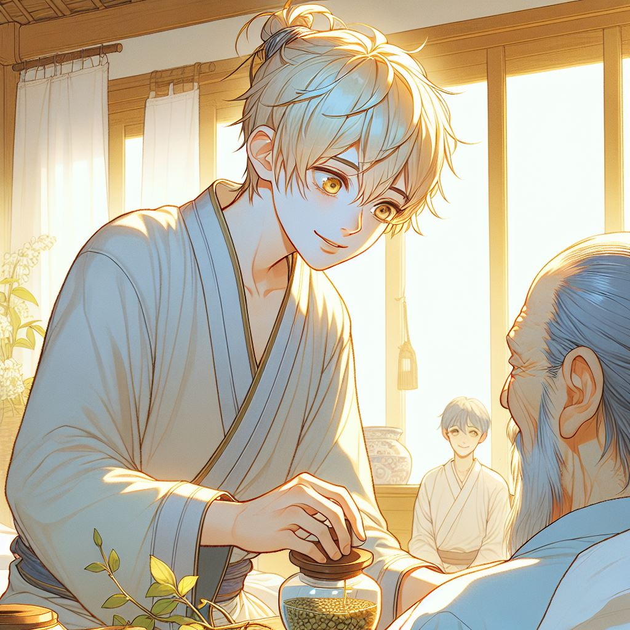
7. 結局
Notes:
Anime-style illustration of a character named Ming, with fair skin, short blond and blue hair, and yellow eyes, carefully preparing and using the medicinal herbs he collected to heal his grandfather. Ming’s expression is filled with relief and happiness as he watches his grandfather, who is lying in bed and beginning to recover. The room is softly lit, with a warm, peaceful atmosphere, showing a sense of accomplishment and love. The scene captures the touching and triumphant moment of Ming’s journey coming to a successful end in classic Japanese anime style.

